Slide 1

Redacting and Marking with Adobe Pro X
Notes:
There are several ways to redact a document to remove PII or sensitive information like permanent markers and correction tape to name two. But did you know that you can use Adobe Acrobat Pro X to redact a PDF document? Additionally, you can remove all of the “metadata” from a document, as well as even mark exhibits! This presentation will walk you through the process to accomplish those things.

Slide 2
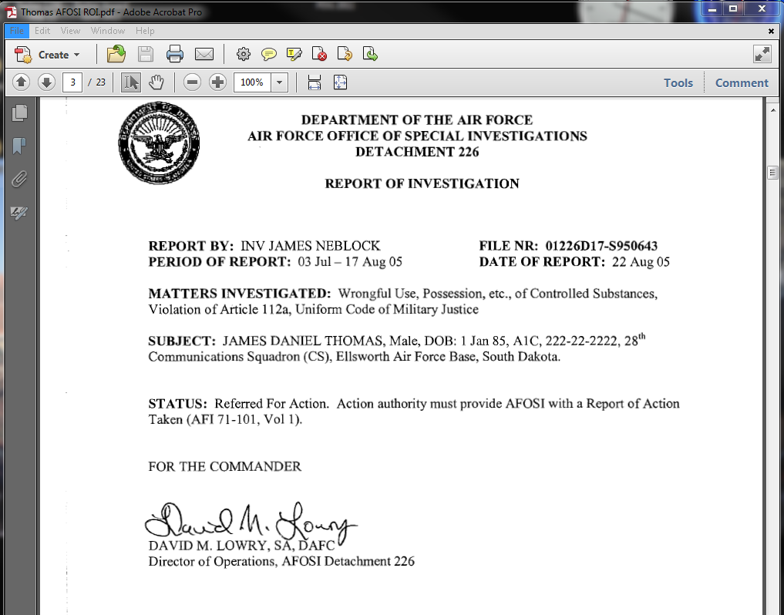
Let’s start with an OSI Report of Investigation

Slide 3
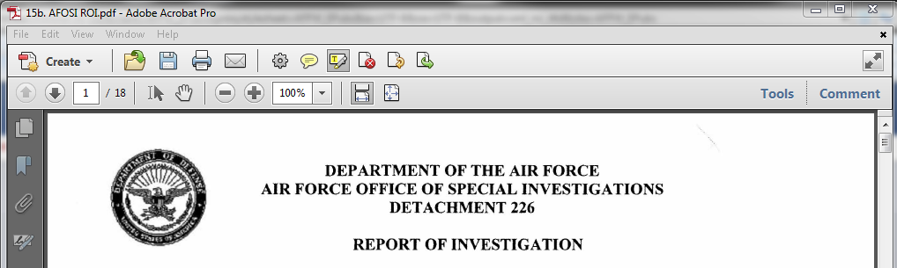
What needs to be redacted?
To redact the information, first go to “Tools”
Notes:
What needs to be redacted on this page? The PII that stands out is the Dates of Birth as well as the Social Security Numbers. To redact the information, first go to “Tools”

Slide 4
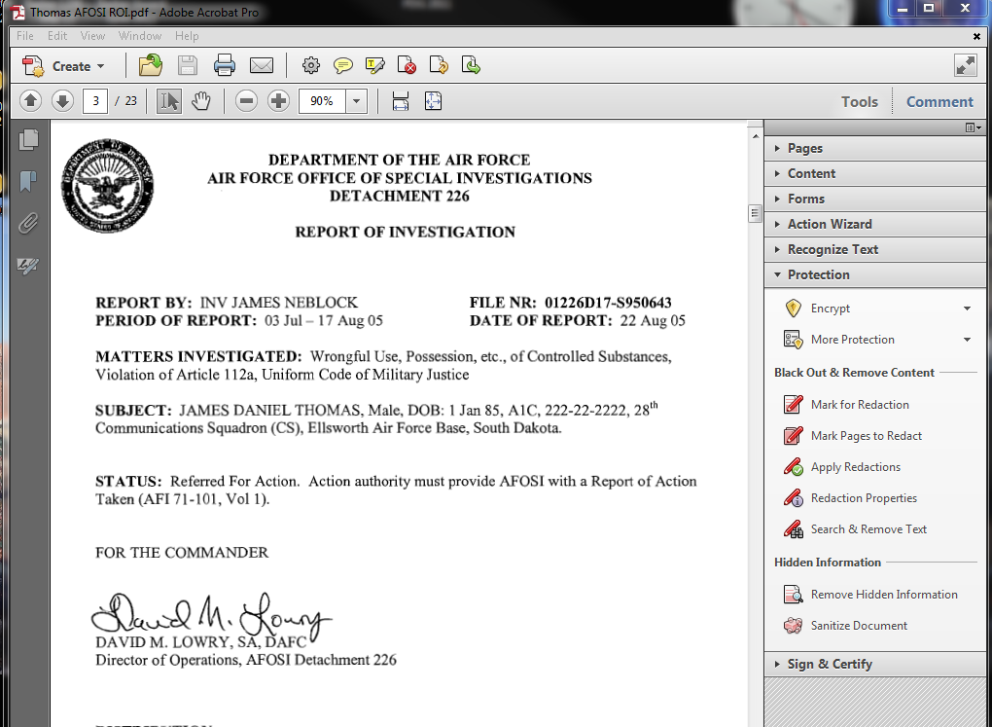
What needs to be redacted?
Then select “Protection.”

Slide 5
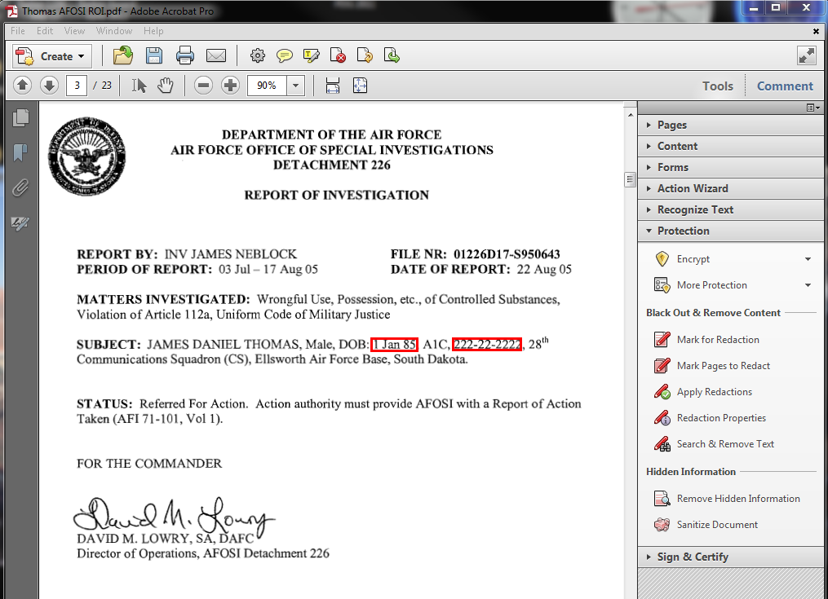
What needs to be redacted?
Next, select “Mark for Redaction,” and select what you want to redact.

Slide 6
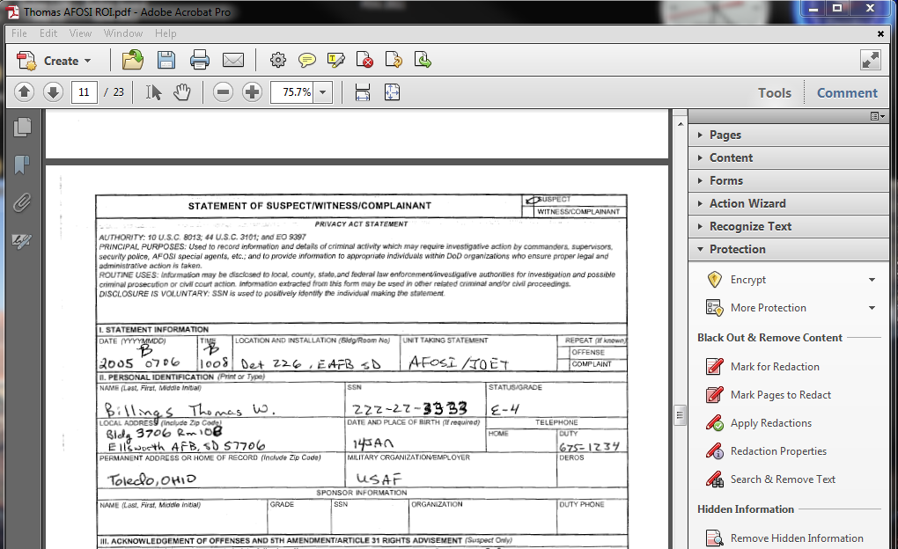
Witness Statement
Notes:
Now, you can scroll through the ROI to find other areas that may need redaction. Let’s look at a witness statement and what we would redact here.

Slide 7
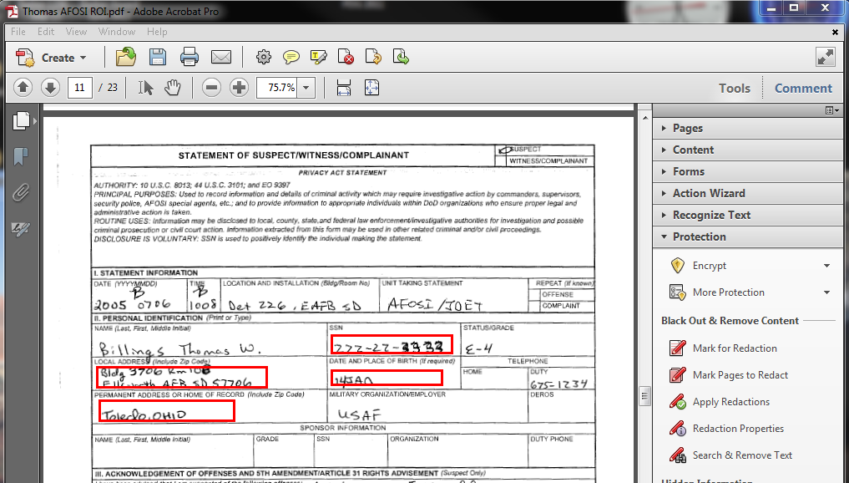
What needs to be redacted?
Select what needs to be redacted, and then continue on throughout your document.

Slide 8
Apply Redaction
When you are finished finding all that needs redaction, simply select “Apply Redaction.”
Notes:
And your information is redacted! Now, there is no having to use a marker and then re-copy or re-scan. The black box is there forever and cannot be removed. But what is that box that popped up? It is asking if you would like to remove the hidden information in your document. Select yes!

Slide 9
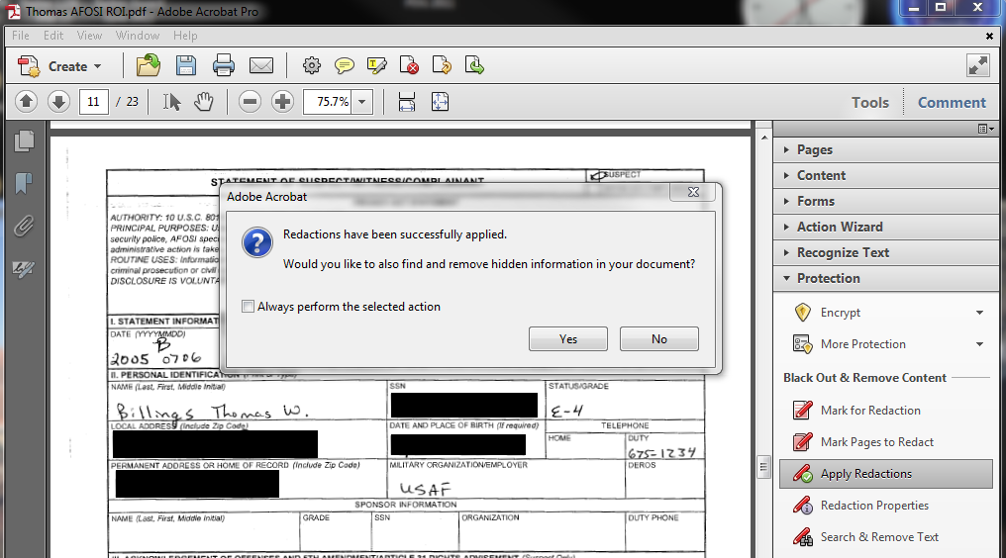
Removing Hidden Data
Notes:
But what is that box that popped up? It is asking if you would like to remove the hidden information in your document. Select yes!

Slide 10
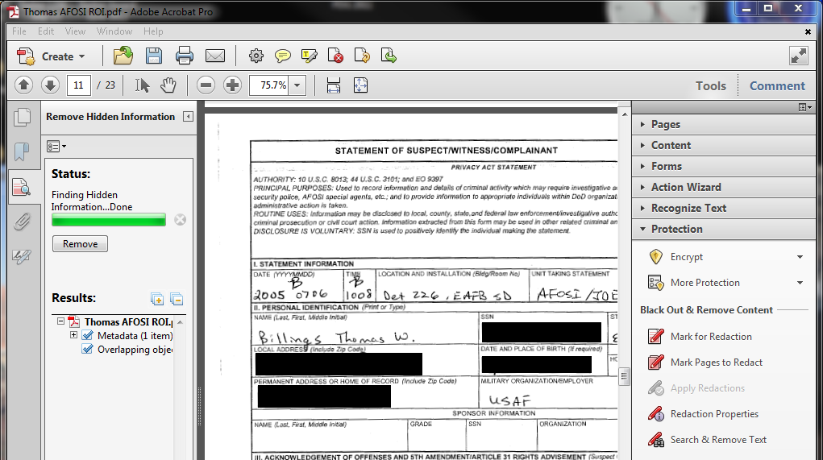
Removing Hidden Data
Notes:
-The program will then search your document looking for “metadata” and hidden objects or images. This could be information that the document saves about certain images, like what was in the box you just redacted! So you want to remove all hidden information. We want this to be clean document in which the recipient gets only what they should have.
-When the program finishes searching for hidden images or data, select “Remove.”
-So that is redaction. It really makes things much easier if you have a lot of documents to redact. It eliminates having to print out, redact, re-scan, etc.
-One more thing...when you save the document, it automatically ads “redacted” to the end of the file save name, so you won’t get confused as to which one to send. This makes your electronic discovery much easier to manage. Now let’s continue on to marking.

Slide 11
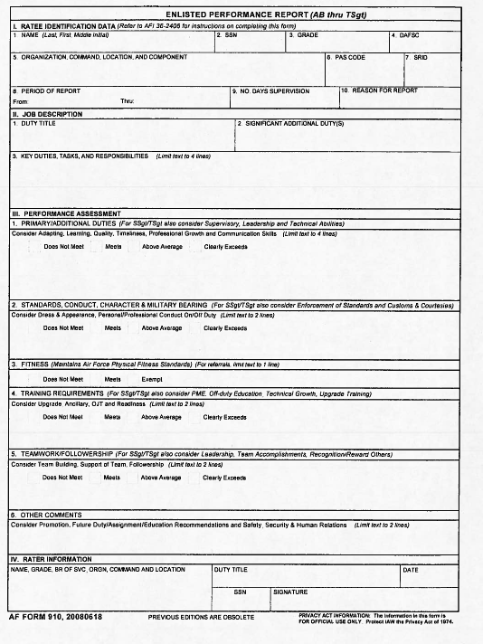
Marking Exhibits
Let’s say you have a scanned PDF file EPR to submit as a prosecution exhibit.
Notes:
Next, did you know you can easily mark your PDF files that are going to be exhibits without having to print them out, stamp them, then re-scan them or copy them? It is just as easy!
We need to get it marked, right? Well, instead of printing it off, marking it, and then re-scanning it, you can simply mark it right through Adobe Acrobat Pro X.

Slide 12
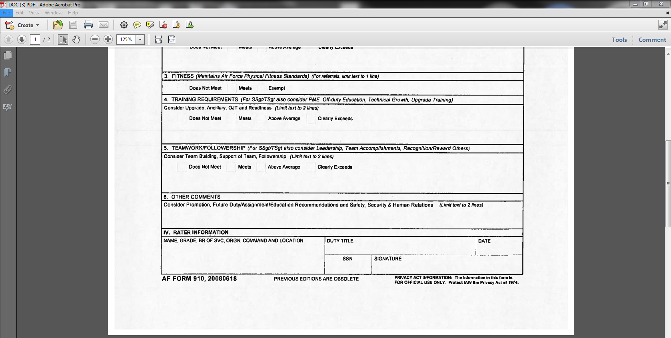
Marking Exhibits
First, select “Tools” like before.

Slide 13
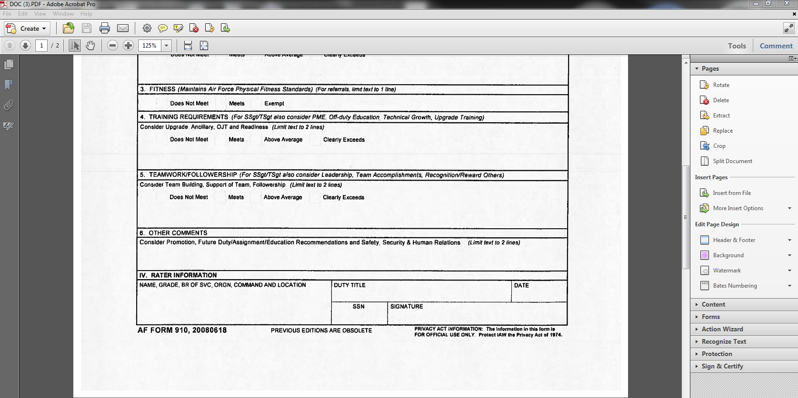
Marking Exhibits
Then, select “Pages,” then “Header & Footer, then “Add Header & Footer.”

Slide 14
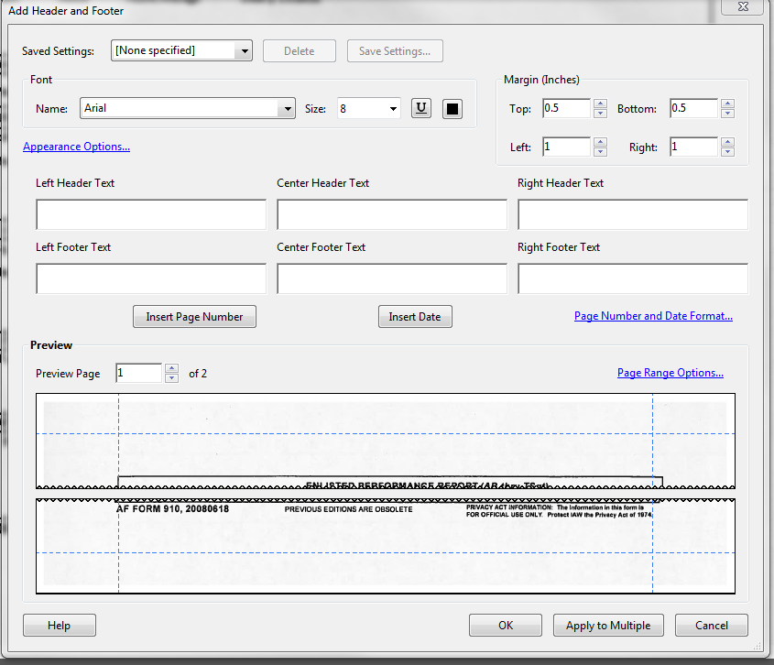
Marking Exhibits
That will give you this box
Notes:
All you have to do is type what you want in the “Right Footer Text” box. You can also change what size you want it to be, and where it is in relation to the bottom of the page by adjusting the margins. See example on next slide.
But hold on...if you do that, it will put it on every page, and we need to specify what page number each page is, i.e. page 1 of 2, page 2 of 2. The way you do that is to select “Page Range Options,” and then specify what page you want to be on.

Slide 15
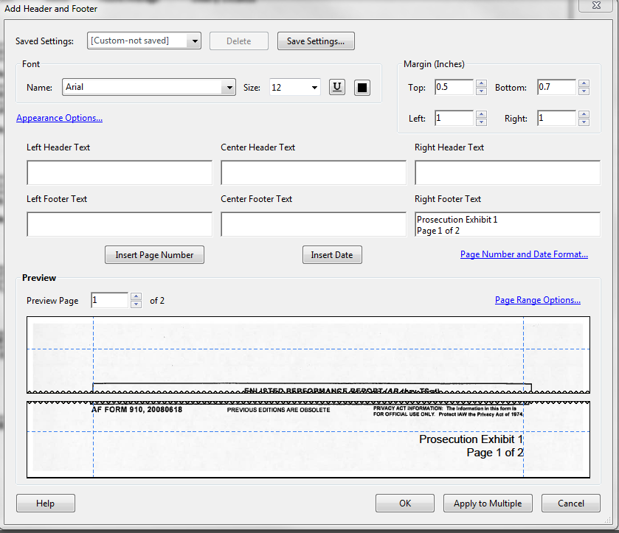
Marking Exhibits
Changing each page
Notes:
All you have to do is type what you want in the “Right Footer Text” box. You can also change what size you want it to be, and where it is in relation to the bottom of the page by adjusting the margins. See example on next slide.
But hold on...if you do that, it will put the stamp on every page, and we need to specify what page number each page is, i.e. page 1 of 2, page 2 of 2. The way you do that is to select “Page Range Options,” and then specify what page you want to be on.

Slide 16
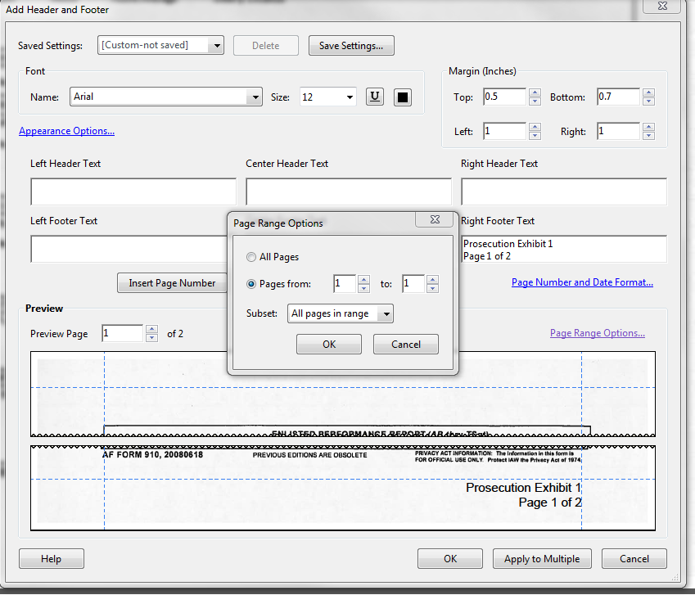
Marking Exhibits
That will give you this box
Notes:
For page 1, select “Pages From” and make both 1. For page 2, Select “Pages From” and make them both 2.

Slide 17
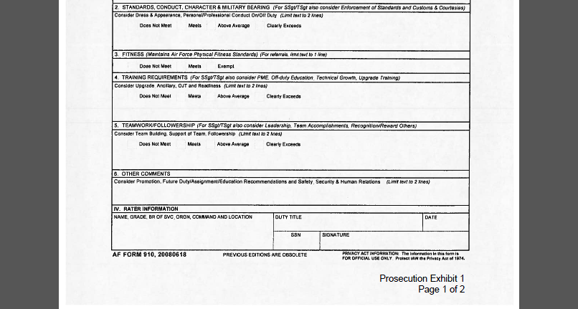
Marking Exhibits
That gives you two independently marked documents, and saves you a bunch of time!
Notes:
- For page 1, select “Pages From” and make both 1. For page 2, Select “Pages From” and make them both 2.
- So that is it! I hope you see the benefit of this great tool. It can save you valuable time, as well as give you a way to track everything electronically in some easy to follow steps.

